Slide 1
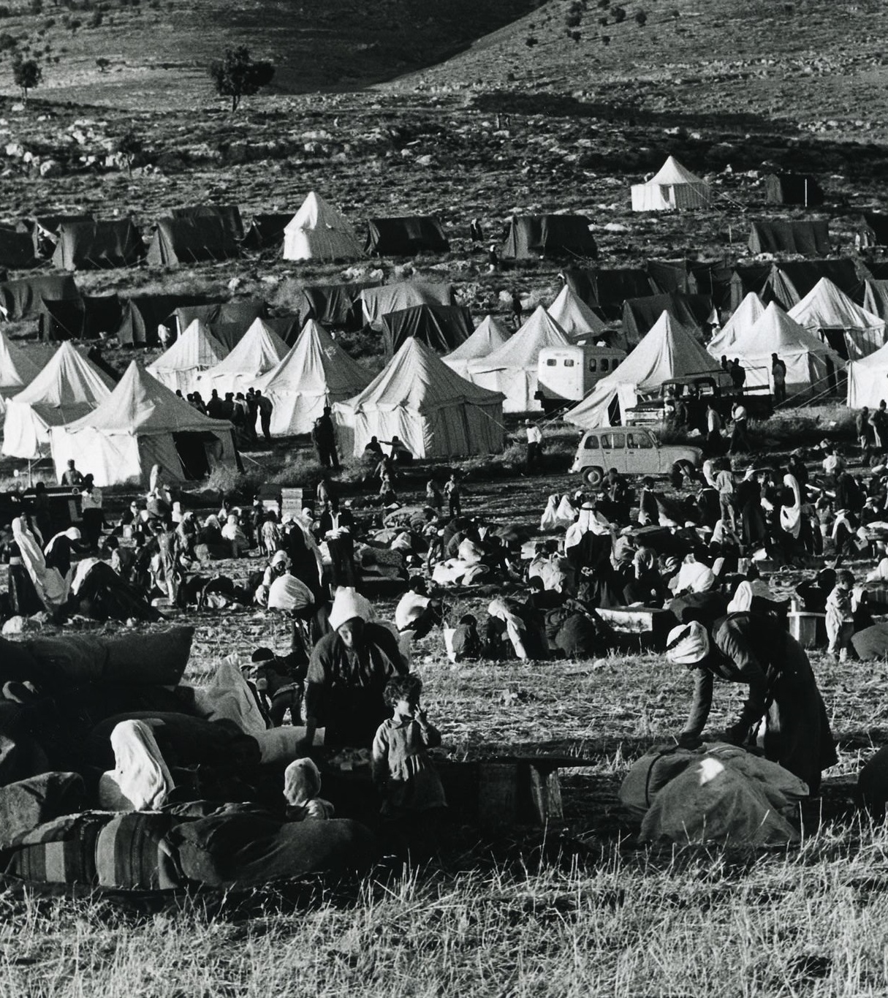
What were the consequences of the June 1967 War?
Lesson 9

Slide 2
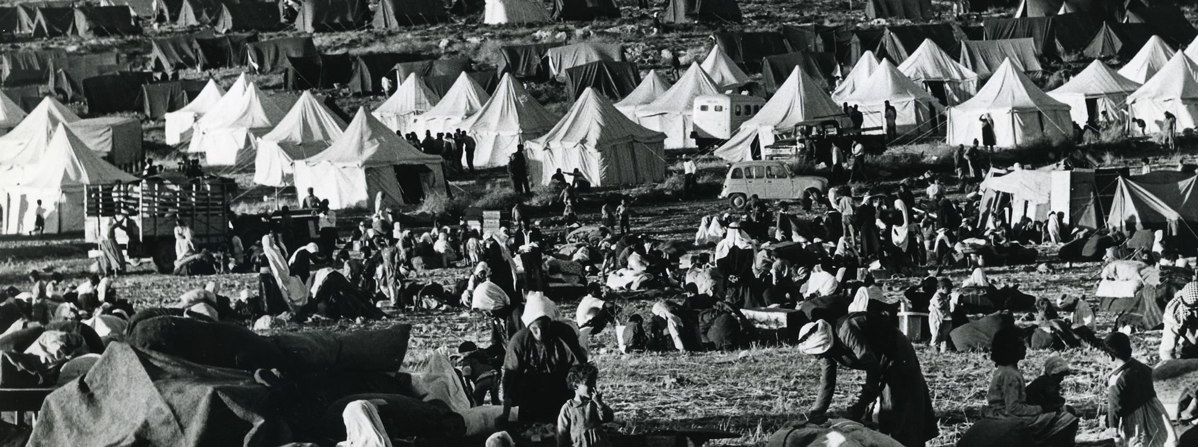
Learning objectives
By the end of this lesson, you should be able to:
Identify the increasing tension in the build up to the June 1967 War
Describe the events of 1967
Explain the consequences of 1967 for the Palestinians

Slide 3
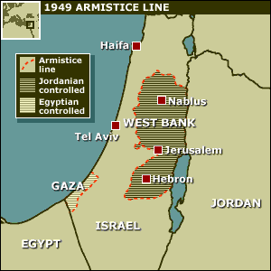
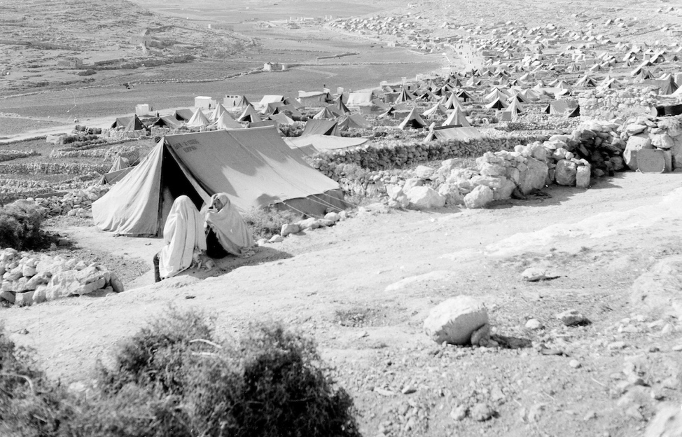
Recap in small groups:
What did the map of Palestine-Israel look like between 1948 and 1967?
1) Who controlled the following areas:
The new state of Israel
The West Bank
Gaza
2) Where did the Palestinians now live?
→ Israel
→ Jordan
→ Egypt
1. Within the new state of Israel, as second-class citizens
3. In Gaza, under Egyptian control
4. In big tented refugee camps run by UNRWA in Jordan, Lebanon and Syria
2. In the West Bank, under Jordanian control

Slide 4
9a. Keywords wordsearch
Occupation
Settlements
Golan Heights
Sinai Peninsula
Naksa
Extension questions:
Have you come across any of these words before?
Can you define them?

Slide 5
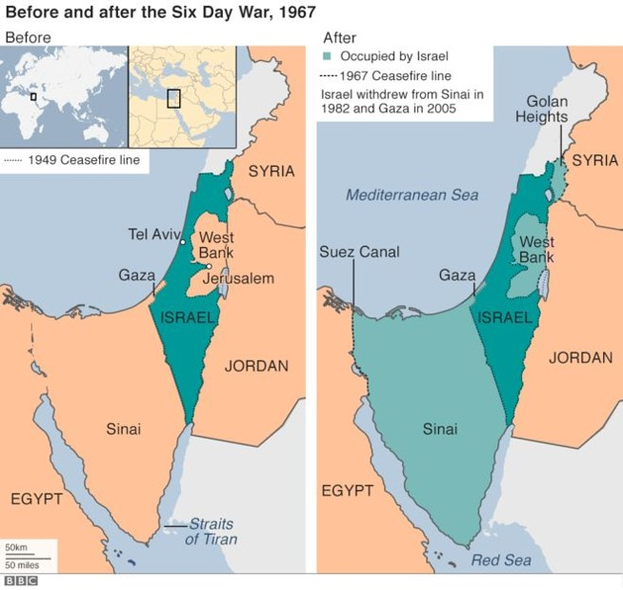
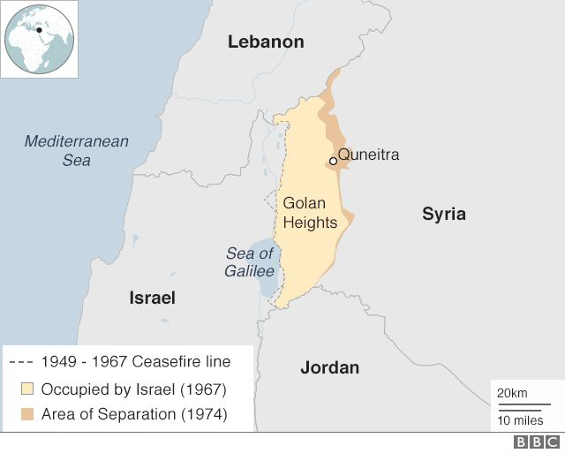
9b. Matching activity
A desert region between the Mediterranean Sea and the Red Sea. A land bridge between Asia and Africa
Occupation
Invasion and temporary control over a territory
Settlements
A rocky plateau in south-western Syria
Golan Heights
Meaning ‘setback’, this refers to the Israeli occupation of the West Bank, Gaza and East Jerusalem in 1967
Sinai Peninsula
Naksa
The establishment of small communities
Can you match the keywords with the definitions?

Slide 6
Add these keywords and matching definitions to your glossary
Occupation
Invasion and temporary control over a territory
Settlements
The establishment of small communities
Golan Heights
A rocky plateau in south-western Syria
A desert region between the Mediterranean Sea and the Red Sea. A land bridge between Asia and Africa
Sinai Peninsula
Meaning ‘setback’, this refers to the Israeli occupation of the West Bank, Gaza and East Jerusalem in 1967
Naksa
Question: what does ‘occupation by settlers’ mean?

Slide 7
Called for Israel’s withdrawal from land occupied during the 1967 war
June 1967 War
1978 Camp David Accords
Political agreements between Israel and Egypt about Israel and Palestine
UN Resolution 242
A six-day war between Israel, Egypt, Jordan and Syria in 1967
Add these to your glossary too

Slide 8
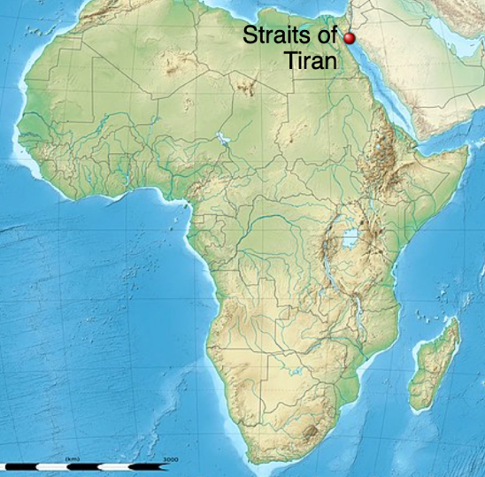
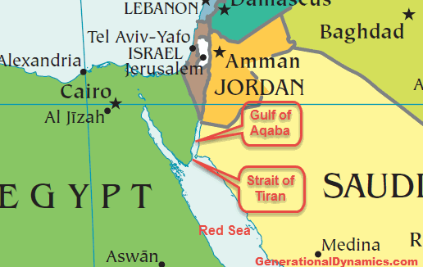
June 1967 War
Also known as the ‘Third Arab-Israeli War’
What were the first and second Arab-Israeli Wars?
1) 1948 war between Israel and the surrounding Arab countries which resulted in Israel expanding its territory to include 78% of Mandate Palestine
2) 1956 war between Israel, Britain, France and Egypt over Nasser and the Suez Canal
Tension had been increasing between Israel and Egypt over access to the Straits of Tiran → the narrow sea passage which is strategically important to both Israel and Egypt (in 1967, 90% of Israel’s oil came through this)
Tension had also been increasing between Israel and Syria in the north
On 22nd May, Nasser closed the Straits of Tiran to Israeli shipping
There was compulsory military service in Israel at this time, so Israel was ready to fight
30th May 1967: a defence agreement was signed between Jordan and Egypt
On the morning of 5th June, Israel attacked Egypt. The war had started…

Slide 9
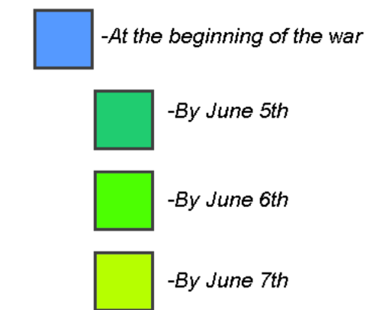
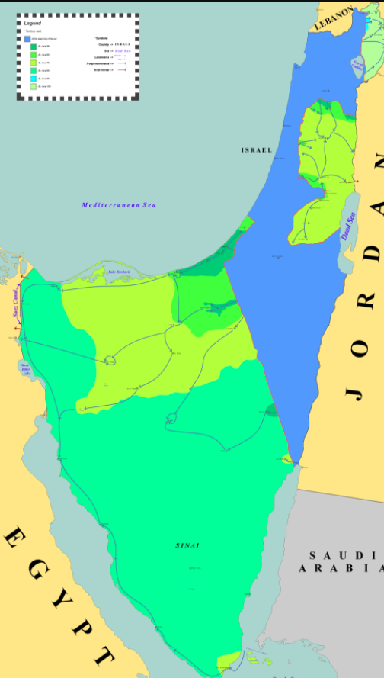
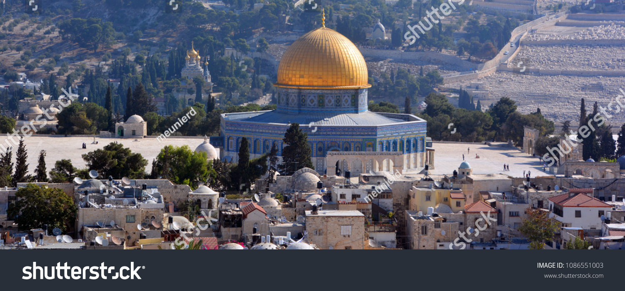
The Six Days of the War
Territory held by Israel
5th June / Day 1: Israel launches a surprise attack on Egyptian air forces and also attacks Syrian, Jordanian and Iraqi air forces. By midday, all of Egypt’s airfields and most of Egypt’s planes have been bombed. Israel also enters the Sinai Peninsula. Jordan’s airfields and air forces are also attacked, and Jordan responds by attacking Israeli cities including West Jerusalem
6th June / Day 2: extensive fighting between Israeli and Jordanian forces across the West Bank, particularly over control of Jerusalem
7th June / Day 3: Israel captures East Jerusalem and the Old City of Jerusalem including the Western Wall and the Dome of the Rock
Can you remember why Jerusalem is significant to Jews, Muslims and Christians?

Slide 10
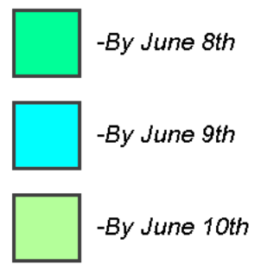
The Six Days of the War
Territory held by Israel
8th June / Day 4: Israeli forces capture the Sinai Peninsula. They also capture the West Bank, with 300,000 refugees fleeing to Jordan
9th June / Day 5: Israeli forces capture the Golan Heights, taking most of it from Syria
10th June / Day 6: Israeli forces capture even more of the Golan Heights. Jordan, Egypt and Syria all accept the UN’s call for a ceasefire
Can you remember when and why the UN was established?

Slide 11
9c. Using this information, create a table of what happened in 1967 for various parts of Palestine-Israel and the surrounding areas
Area | Who controlled it before 1967? | What happened in the June 1967 War?
Israel | The new state of Israel | Various cities in Israel were attacked by Jordan, including West Jerusalem. But Israel retained control
West Bank | Jordan | After fighting between Israel and Jordan, Israel occupied the area
Gaza
East Jerusalem and the Old City of Jerusalem
Sinai Peninsula
Golan Heights
Occupation
Invasion and temporary control over a territory

Slide 12
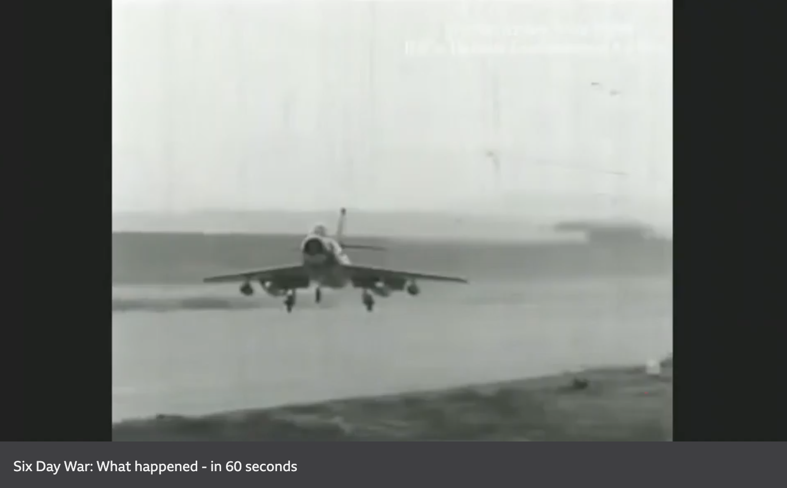
Watch this BBC video ‘Six Day War: What happened - in 60 seconds’ Add any missing information to your table
https://www.bbc.co.uk/news/world-middle-east-39960461

Slide 13
9c. Using this information, create a table of what happened in 1967 for various parts of Palestine-Israel and the surrounding areas
Area | Who controlled it before 1967? | What happened in the June 1967 War?
Israel | The new state of Israel | Various cities in Israel were attacked by Jordan, including West Jerusalem. But Israel retained control
West Bank | Jordan | After fighting between Israel and Jordan, Israel occupied the area
Gaza
East Jerusalem and the Old City of Jerusalem
Sinai Peninsula
Golan Heights
Egypt
After fighting between Israel and Egypt, Israel occupied the area
Jordan
After fighting between Israel and Jordan, Israel occupied the area
Egypt
After fighting between Israel and Egypt, Israel occupied the area (until 1982)
Syria
After fighting between Israel and Syria, Israel occupied the area
Occupation
Invasion and temporary control over a territory

Slide 14
What were the consequences of the June 1967 War?

Slide 15
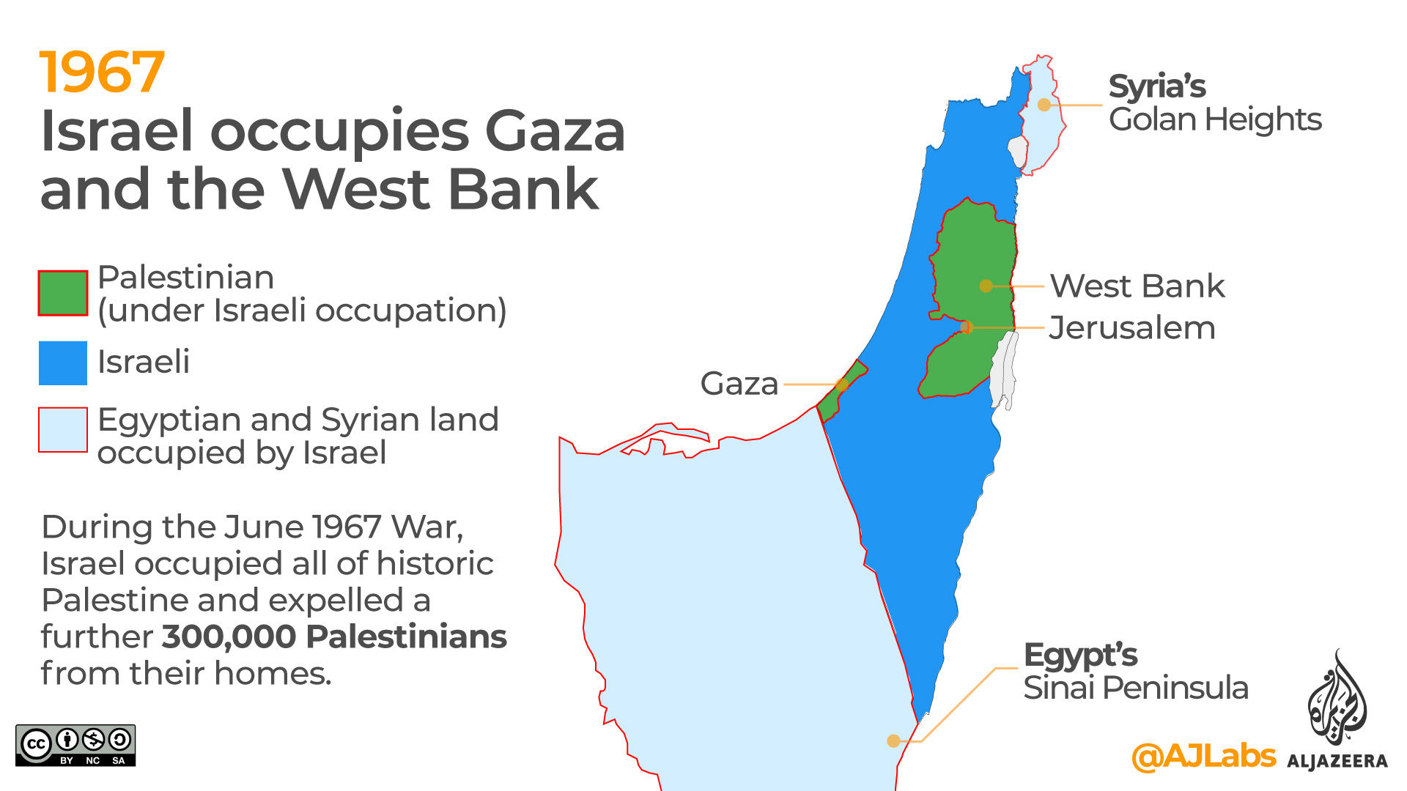
What does this map tell us about the consequences of the 1967 war?
Are any parts of Palestine-Israel not under Israeli occupation here?

Slide 16
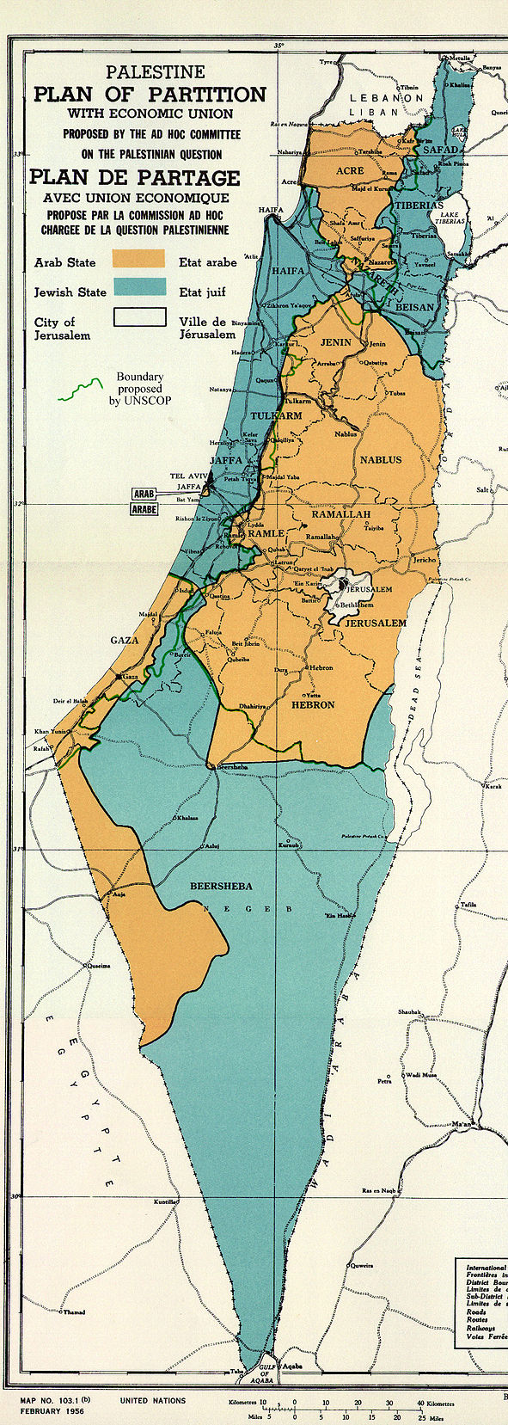
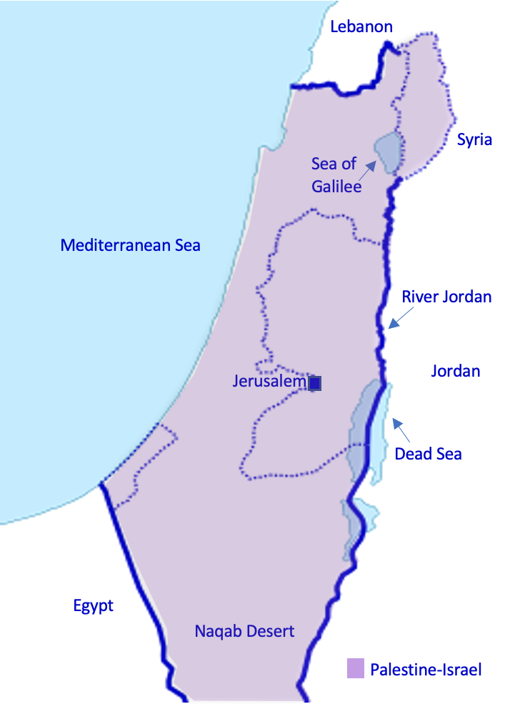
9d. Imagine you were born in Palestine-Israel in 1900. In your book, write a short description of how things have changed, finishing in 1967.
Palestine during the British Mandate
(1918-1948)
The new borders after the 1948 Arab-Israeli war
Palestine-Israel before WWI
(pre-1918)
UN Partition Plan in November 1947
The situation after the June 1967 War
Pre-1918
1918
1947
1948
1967
18 years old
47 years old
48 years old
67 years old

Slide 17
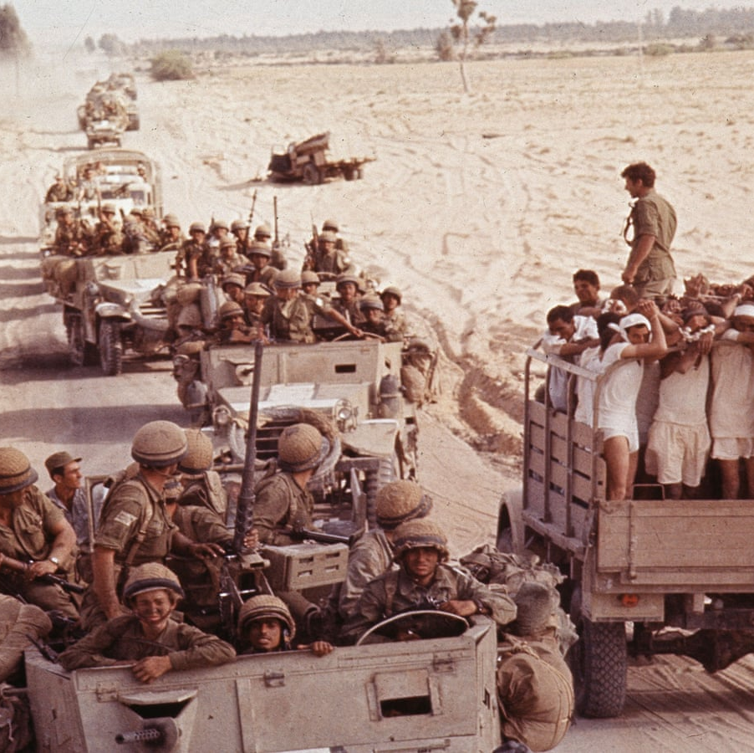
The death toll
Around 800 Israelis were killed and 4000 were wounded
Around 20,000 Arabs (including Palestinians) were killed

Slide 18
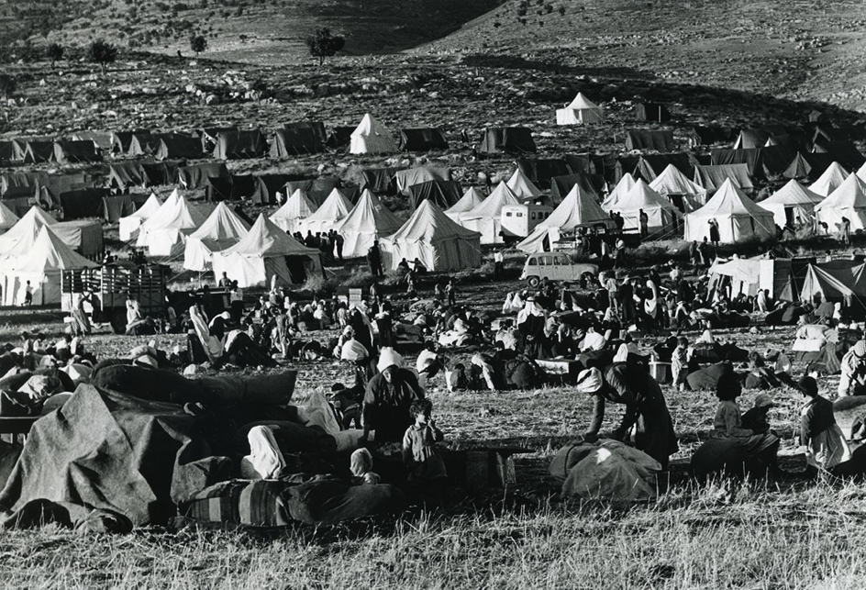
More consequences of 1967
Occupation
Settlements
Naksa
Invasion and temporary control over a territory
The establishment of small communities
Meaning ‘setback’, this refers to the Israeli occupation of the West Bank, Gaza and East Jerusalem in 1967
As we have seen, 1967 was a huge military victory for Israel: by occupying the West Bank, Gaza, East Jerusalem, the Golan Heights and the Sinai Peninsula, the territory under Israel’s control had quadrupled (4x)
But, 300,000 more Palestinians had become refugees
This is why 1967 is also known as the ‘Naksa’ meaning ‘setback’
Some of the Palestinian territory occupied by Israel in 1967 had religious significance, for example Jerusalem and Hebron
This encouraged thousands of Israelis to establish settlements in the West Bank and Gaza. The state of Israel invested in infrastructure for these settlers (eg. roads) and life became increasingly difficult for the 1 million Palestinians who were now living under Israeli occupation (for example their agricultural land was taken from them by Israeli settlers)
1967 refugee camp
In small groups, plan an answer to this exam-style question:
Explain two consequences of the June 1967 War [8 marks]

Slide 19
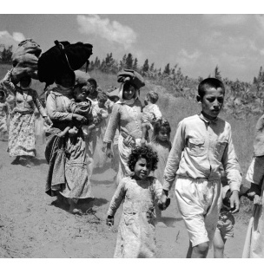
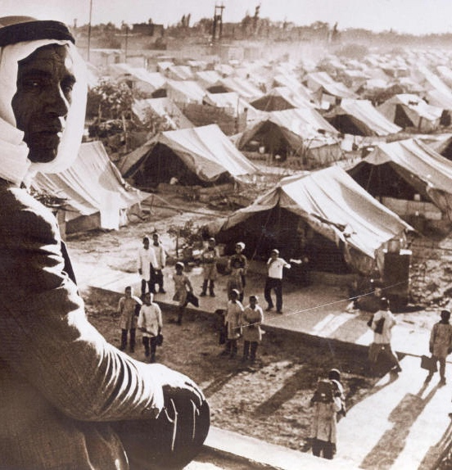
UN Resolution 242
UN Resolution 194: a resolution adopted by the UN in 1948 which stated that Palestinian refugees should be able to return to their homes or be financially compensated
Right of Return: a principle in international law which guarantees everyone’s right to return to their country
We have seen another UN Resolution in an earlier lesson. What can you remember about UN Resolution 194?
What was the Right of Return?
UN Resolution 242:
Adopted at the end of 1967, with the support of both the USA and the USSR
Key idea: ‘Land for Peace’
Israel must withdraw from territory it had occupied during the June 1967 War
The surrounding Arab countries eg. Egypt and Jordan must recognise Israel’s right to exist
The “refugee problem” should be settled fairly
What did Israelis and Palestinians think of this?
Israelis were divided: they wanted peace, but they also wanted land! It protected them from surrounding Arab countries and it had religious significance too
Palestinians were not happy: how much land would be returned? How was the refugee problem going to be settled fairly?
Eventually Resolution 242 was accepted by the countries mentioned above, despite its lack of clarity. This was going to cause problems…
In just a couple of sentences, can you explain to your partner what UN Resolution 242 was, and why it was problematic?

Slide 20
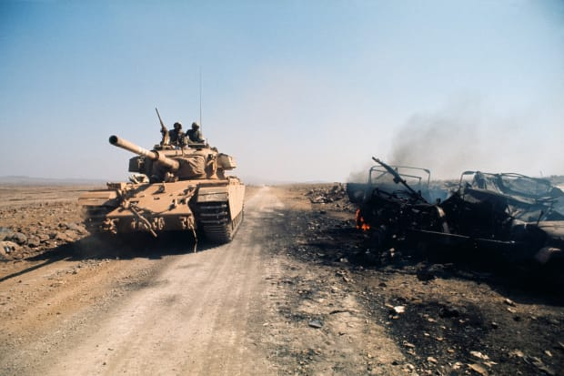
1973 Yom Kippur War and 1978 Camp David Accords
After 1967, the tension continued between Israel and Egypt, particularly over the Suez Canal
This was also becoming an arena for Cold War tension: the USSR was supporting Egypt and the USA was supporting Israel
In 1970, Gamal Abdel Nasser died and was replaced by Anwar Sadat as President of Egypt
On Yom Kippur (the holiest day of the year in Judaism), 6th October 1973, Egypt and Syria attacked Israel
Israel was not prepared for this attack, and at first Egypt and Syria had the upper hand in reclaiming the Israeli-occupied Golan Heights in the north and the Sinai Peninsula in the south
But Israel soon mobilised its troops, managed to reclaim control of the land it had occupied in 1967, and kept pushing further
Pressure from the USA convinced Israel to agree to a ceasefire on 25th October
1978 Camp David Accords → agreements between Israel and Egypt about Israel and Palestine. We’ll return to this in a future lesson

Slide 21
Homework
Using what you have learnt today, write an answer to this exam-style question:
Explain two consequences of the June 1967 War [8 marks]

Slide 22
Plenary:
Answer this question with someone you haven’t yet worked with today, using the vocabulary provided
What happened in June 1967?
Occupation
Straits of Tiran
Refugees
Sinai Peninsula
Golan Heights
West Bank
Naksa
300,000
East Jerusalem

